Slide 1
Representative Samples and the Proper Use of Focus Groups
Jeff Campbell Manager of Information and Research
International Bridge, Tunnel and Turnpike Association

Slide 2
Representative Samples and the Proper Use of Focus Groups
Quantitative Research
Qualitative Research
Notes:
Discuss 3 concepts.

Slide 3
Can you believe public opinion research?
Is the sample mathematically representative of the population being studied?
Are the questions valid and reliable?
Then absolutely!!
Notes:
Discuss 3 concepts.

Slide 4

The Importance of The Sample

Slide 5

Sample Size and Selection Bias
Notes:
Is 1,000 better than 10? Yes and no.

Slide 6
Truly Representative Samples
Define the population you want to study
Take as close to a truly random sample of the population as possible
Evaluate convenience samples to adjust for selection bias
Notes:
Discuss 3 concepts.

Slide 7
A Truly Random Sample of 30 Is Large Enough To Calculate an Accurate Measure of Any Population
Notes:
Is 1,000 better than 10? Yes and no.

Slide 8
Convenience Samples
Notes:
Is 1,000 better than 10? Yes and no.

Slide 9
ALWAYS ASK: Is the sample representative of the population being studied?
Define the population you want to study
Take as close to a truly random sample as possible
Always evaluate convenience samples to adjust for selection bias
Notes:
Discuss 3 concepts.

Slide 10
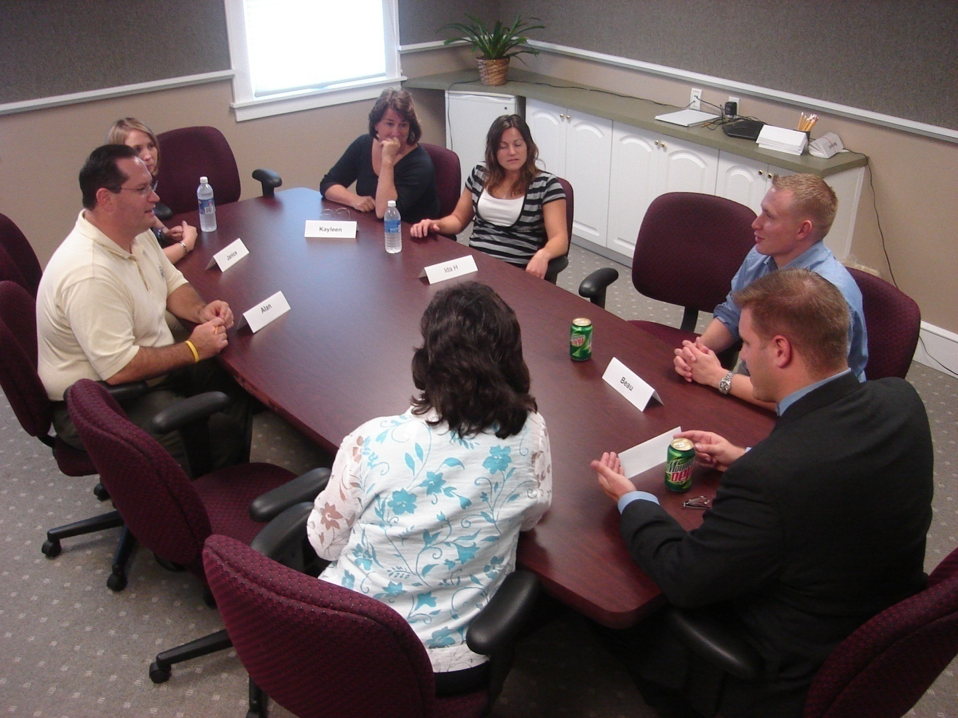
Qualitative Research – Focus Groups and Interviews
Notes:
Qualitative

Slide 11
When to Use a Focus Group
Generate hypothesis
Expand questionnaire
Test Questions
Notes:
Describe.

Slide 12
WARNING: Focus Groups Are NOT Quantitative Studies
Focus groups are NOT representative samples
Group Think, Projection and Other Hazards
Notes:
Discuss.

Slide 13
In-Depth Interviews
Interpretation Bias
Inconsistency of Interview Process
Notes:
Discuss.

Slide 14
Can you believe public opinion research?
Is the sample mathematically representative of the population being studied?
Are the questions valid and reliable?
Then absolutely!!
Notes:
Discuss 3 concepts.

Slide 15
Thank You!
IBTTA’s Data Advisory Group
HTTP://IBTTA.org/Groups
Jeff Campbell Manager of Information and Research
International Bridge, Tunnel and Turnpike Association
Jcampbell@IBTTA.org 202-659-4620 Ext. 16
Notes:
Discuss 3 concepts.

